Slide 1
10 Slides with Data Supporting the op-ed
“Maternal deaths represent the canary in the coal mine for women’s health”
Stat, August 22, 2018 https://www.statnews.com/2018/08/22/maternal-deaths-women-health/
Gene Declercq, PhD
Community Health Sciences Dept.,
Boston University SPH
www.birthbythenumbers.org

Slide 2
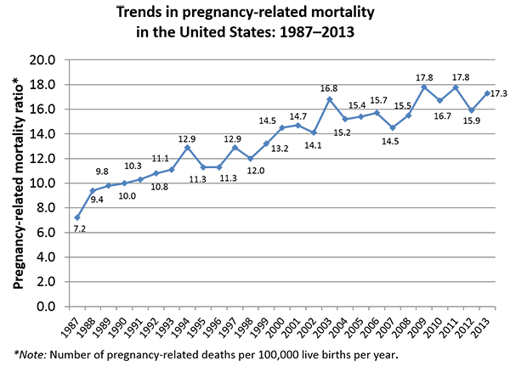
Source: CDC.
Creanga. Pregnancy-Related Mortality in the United States. Obstet Gynecol 2017.
U.S. trending upward since 1987 with wide racial disparities
Pregnancy Related Mortality,
U.S., 1987-2013
Racial Disparities
Rates for 2011-13:
12.7 white women
43.5 black women
11.0 Hispanic
14.4 other races

Slide 3
U.S. MMR* Compared to Industrialized Countries with 300,000+ births, 2014, using WHO Estimates
U.S. ranks last among wealthy countries – even if you limit the U.S. to white mothers.
* Maternal Mortality Ratio per 100,000 births
Source: Maternal Mortality: 1990 to 2015 Estimates by WHO, UNICEF, UNFPA, World Bank Group & UN Population Division. Geneva: 2015. U.S. rates estimated based on adjustment to pregnancy-related mortality rates in Creanga et al. Obstet Gynecol 2017.

Slide 4
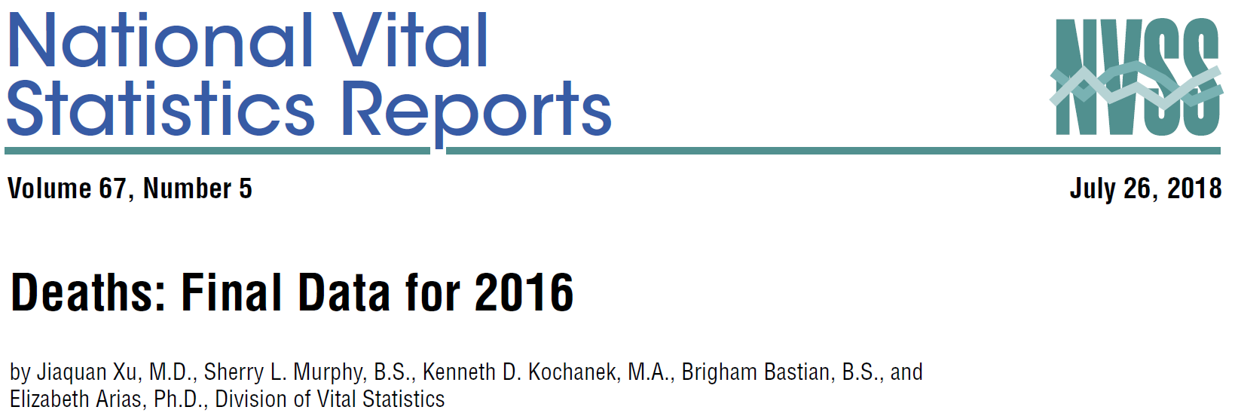
Death Rates for Women 15-44 all increasing in recent years while rates for other age groups continuing to decline or stay steady.
Source: Xu J, Murphy S, Kochanek K, Bastian B, Arias E. Deaths: Final data for 2016. National Vital Statistics Reports; vol 67 no 5. Hyattsville, MD: National Center for Health Statistics. 2018.

Slide 5
Female Death Rates (per 100,000) by Age, 2010-2016
Looking specifically at 2010-2016
40-44
35-39
30-34
25-29
20-24
15-19
Source: Annual Reports of Deaths: Final data. (for respective years). National Vital Statistics Reports; Hyattsville, MD: National Center for Health Statistics

Slide 6
Female Death Rates by Age (per 100,000 in age group), U.S., 2010-2016
For those of you who prefer actual numbers
Year | 15-19 | 20-24 | 25-29 | 30-34 | 35-39 | 40-44
2010 | 28.1 | 44.8 | 55.7 | 72.6 | 102.6 | 154.3
2011 | 28.3 | 44.0 | 55.9 | 76.1 | 103.0 | 156.6
2012 | 27.4 | 44.2 | 57.2 | 74.6 | 102.4 | 153.5
2013 | 26.4 | 44.1 | 56.8 | 75.3 | 104.7 | 154.7
2014 | 26.8 | 44.0 | 58.2 | 76.3 | 108.4 | 158.9
2015 | 29.1 | 46.5 | 60.8 | 83.5 | 110.1 | 159.0
2016 | 30.0 | 50.2 | 67.0 | 90.7 | 119.9 | 162.4
2010-2016 Change | 6.8% | 12.1% | 20.3% | 24.9% | 16.9% | 5.2%
Source: Annual Reports of Deaths: Final data. (for respective years). National Vital Statistics Reports; Hyattsville, MD: National Center for Health Statistics

Slide 7
Top 10 Causes of Death for Women 25-34 in 2010 & 2016
Childbirth related deaths grew at a slower than average rate. Accidents had biggest impact on increase.
 |  | 2010 |  |  |  |  |  | 2016 |  |  | % Change in rate 2010-2016
Rank |  | Total Deaths | % of total | Rate per 100 K |  | Rank |  | Total Deaths | % of total | Rate per 100 K
 | All causes | 13067 | 100 | 64.0 |  |  | All causes | 17,359 | 100.0 | 78.6 | 22.8%
1 | Accidents (unintentional injuries) | 3770 | 28.9 | 18.5 |  | 1 | Accidents (unintentional injuries) | 6,247 | 36.0 | 28.3 | 53.0%
2 | Malignant neoplasms | 1,835 | 14.0 | 9.0 |  | 2 | Malignant neoplasms | 1,966 | 11.3 | 8.9 | -1.1%
3 | Intentional self-harm (suicide) . | 1,092 | 8.4 | 5.3 |  | 3 | Intentional self-harm (suicide) . | 1,479 | 8.5 | 6.7 | 26.4%
4 | Diseases of heart | 1,010 | 7.7 | 4.9 |  | 4 | Diseases of heart | 1,141 | 6.6 | 5.2 | 6.1%
5 | Assault (homicide) | 684 | 5.2 | 3.3 |  | 5 | Assault (homicide) | 836 | 4.8 | 3.8 | 15.2%
6 | Pregnancy, childbirth & puerperium | 367 | 2.8 | 1.8 |  | 6 | Pregnancy, childbirth & puerperium | 472 | 2.7 | 2.1 | 16.7%
7 | Diabetes mellitus | 262 | 2.0 | 1.3 |  | 7 | Chronic liver disease and cirrhosis | 360 | 2.1 | 1.6 | 77.8%
8 | Human immunodeficiency virus (HIV) disease | 259 | 2.0 | 1.3 |  | 8 | Diabetes mellitus | 336 | 1.9 | 1.5 | 15.4%
9 | Cerebrovascular diseases | 253 | 1.9 | 1.2 |  | 9 | Cerebrovascular diseases | 244 | 1.4 | 1.1 | -8.3%
10 | Chronic liver disease and cirrhosis | 180 | 1.4 | 0.9 |  | 10 | Septicemia | 210 | 1.2 | 1.0 | NA
 | All other causes (residual) | 3,355 | 25.7 | 16.4 |  |  | All other causes (residual) | 4,068 | 23.4 | 18.4 | 12.2%
Sources: Heron M. Deaths: Leading causes for 2010. National vital statistics reports; vol62 no 6. Hyattsville,MD: National Center for Health Statistics. 2013 & Heron M. Deaths: Leading causes for 2016. National Vital Statistics Reports; vol 67 no 6. Hyattsville, MD: National Center for Health Statistics. 2018.

Slide 8
Cause-specific proportionate pregnancy-related mortality: United States, 1987–2013.
Specific clinically related causes declining while cardiac related & “other” conditions rising
-60%
-58%
-60%
-23%
-21%
-92%
+417%
+96%
+83%
+67%
Source: Adapted from Creanga. Pregnancy-Related Mortality in the United States. Obstet Gynecol 2017.

Slide 9
Timing of Maternal Deaths
Almost two-thirds of maternal deaths occur outside of the week of birth
Source: Creanga A et al. Pregnancy Related Mortality in the U.S., 2011-2013. Obstet & Gynec 2017 & MMRIA (2017).

Slide 10
State Eligibility for Medicaid Coverage
Women are often dropped from Medicaid within 60 days of giving birth if they don’t meet the overall adult standard (e.g. by making more than $3,740 in Alabama) .
States with toughest eligibility for non-pregnant adult women. Percent of poverty level you must be below to qualify for Medicaid
 | % of poverty level not pregnant | $ Amount (family of 3) | % poverty level when pregnant
Alabama | 18% | $3,740 | 146%
Texas | 18% | $3,740 | 203%
Missouri | 22% | $4,571 | 201%
Idaho | 26% | $5,402 | 138%
Mississippi | 27% | $5,610 | 199%
Florida | 33% | $6,857 | 196%
Georgia | 36% | $7,480 | 225%
Kansas | 38% | $7,896 | 171%
Virginia | 38% | $7,896 | 148%
N. Carolina | 43% | $8,935 | 201%
Massachusetts | 138% | $28,676 | 205%
Source: Kaiser Family Foundation

Slide 11
For more data and free teaching materials go to: www.birthbythenumbers.org
Twitter: @BirthNumbers
Email: birthbynumbers@gmail.com
FACEBOOK: www.facebook.com/BirthByTheNumbers
Notes:
If you have questions for us, please reach out to use at one of these addresses and follow us on Facebook and Twitter.

