Slide 1
Birth By the Numbers 2017
Is there a problem in the U.S.?
Gene Declercq, PhD
www.birthbythenumbers.org
With support from:
The Transforming Birth Fund
Updated as of February, 2017
BirthByTheNumbers.org
Notes:
There are inevitable delays in releasing data, though the national Center for Health Statistics has made great progress in recent years in more timely release of the data. The final data for 2015 was released on 1/5/17. This is in fact faster than many states release their data.

Slide 2
38,542
3,977,745
11,442
9.2%
1,272,503
$62,689,000,000
$18,570
BirthByTheNumbers.org
Notes:
Each of these numbers is updated for these slides and their earlier version was presented at some point in the talk.

Slide 3
Total U.S. Births, 1990-2015
Source: Adapted from CDC VitalSTATS. http://www.cdc.gov/nchs/VitalStats.htm
BirthByTheNumbers.org
Notes:
U.S. Births have dropped substantially since 2007, though there was a slight increase between 2013-2014. This correspondeds initially to the recession. What’s most notable at this point is that as the economy has recovered the number of births haven’t gone back up. This is largely the result of a major drop in the birth rate among Hispanics.

Slide 4
U.S. Fertility Rates (per 1,000) by Race/Ethnicity, 1989-2015
Fertility rates computed by relating total births, regardless of age of mother, to women 15-44 years.
Notes:
Note that most of the decrease has been the result of a decline in the Hispanic birth rate

Slide 5
Prematurity and Low Birthweight, U.S., 1981-2015
Year
BirthByTheNumbers.org
Notes:
Prematurity has decreased notably in recent years, because of a national effort to do so, led by the March of Dimes.

Slide 6
Percent of all births at home, or in a birthing center, United States, 1990-2015
66% Increase
2004-2015
57,434
(1.44%)
46,956
(1.13%)
35,587
(0.87%)
38,542
0.97%
Total home &
birth center
Home
18,892
0.47%
Birthing center
Source: NCHS Annual Birth Reports &
CDCVitalStats. http://www.cdc.gov/nchs/nvss.htm
BirthByTheNumbers.org
Notes:
Home births approached 1% of all births in 2015 reaching the highest level (0.97%) since recording of home births began in 1989. The proportion of births in freestanding birth centers also reached a new high of 0.47% in 2015. In all, 57,434 births occurred out of hospital in the U.S., a total of 1.44% of all births. After a slow, steady decline from 1990-2004, the number of out of hospital births began to grow after 2004, increasing by 66% overall between 2004 and 2015. The rapid increase in out-of-hospital births that began after 2004 slowed a bit between 2014 and 2015 as the annual increase was the smallest since a 2010-2011.

Slide 7
Is the U.S. really doing as badly as it seems in international comparisons?
Notes:
The context for this question are the annual reports (e.g. WHO Health Statistics or State of the Worlds Children) of international statistics which regularly report that the US ranks somewhere around 40th in measures like infant or neonatal mortality.
The problem with such claims is that they involve a number of countries that are not comparable to the US in size, wealth or demographic diversity.

Slide 8
Is the U.S. really doing that badly?
How Do we Compare Outcomes?
Neonatal Mortality Rate
Infant Deaths in
First 28 days
X 1,000
________________
Live
Births
Notes:
Helps to note what this captures (early deaths) and what it does not, especially in cross-national comparisons. It is only a rough measure of the quality of the maternity care system since some of the causes of death (e.g. congenital anomalies) predate childbirth and have nothing to do with the childbirth itself. Also different countries can have different customs concerning how a live birth is measured. These differences usually center on what counts as a live birth (a determination usually based on birthweight and gestational age or in some cases “a breath.”

Slide 9
Outcomes: Comparative Neonatal Mortality Rates
Rank | Country | Rank | Country | Rank | Country
1 | Andorra (1/1,000) | 14 | Czech Republic | 27 | Sweden
 | Finland |  | Denmark |  | Canada (3/1,000)
 | Iceland |  | Estonia |  | Croatia
 | Japan |  | France |  | Cuba
 | Luxembourg |  | Germany |  | Greece
 | San Marino |  | Ireland |  | Lithuania
 | Singapore |  | Israel |  | Netherlands
8 | Australia (2/1,000) |  | Italy |  | New Zealand
 | Austria |  | Monaco |  | Poland
 | Bahrain |  | Norway |  | Spain
 | Belarus |  | Portugal |  | Switzerland
 | Belgium |  | Repub. of Korea |  | United Kingdom
13 | Cyprus | 26 | Slovenia | 39 | United States (4/1,000)
Source: State of the World’s Children2015.
BirthByTheNumbers.org
Notes:
NOTE: Number in parentheses represents the neonatal mortality rate for that country (e.g. Australian NMR = 2 per 1000 live births). Ties in rank simply mean that cluster of countries reports the same rate.
Faculty may want to ask students if they’d heard of some of the smaller countries and ask them to guess about how many births they have in a year, noting that the US has almost 4 million annually.

Slide 10
Outcomes: Comparative 2015 Neonatal Mortality Rates
Rank | Country | Rank | Country | Rank | Country
1 | Andorra (1) | 14 | Cyprus | 29 | United Kingdom
 | Bahrain |  | Czech Republic |  | Canada (3)
 | Finland |  | Estonia |  | Croatia
 | Iceland |  | France |  | Denmark
 | Japan |  | Germany |  | Greece
 | Luxembourg |  | Ireland |  | Kuwait
 | San Marino |  | Israel |  | Lithuania
 | Singapore |  | Italy |  | Montenegro
9 | Slovenia |  | Monaco |  | New Zealand
 | Australia (2) |  | Netherlands |  | Poland
 | Austria |  | Norway |  | Spain
 | Belarus |  | Portugal |  | Switzerland
 | Belgium |  | Republic of Korea | 41 | United States (4)
14 | Cuba | 28 | Sweden
Source: State of the World’s Children 2016.
BirthByTheNumbers.org
Notes:
NOTE: Number in parentheses represents the neonatal mortality rate for that country (e.g. Australian NMR = 2 per 1000 live births). Ties in rank simply mean that cluster of countries reports the same rate.
Faculty may want to ask students if they’d heard of some of the smaller countries and ask them to guess about how many births they have in a year, noting that the US has almost 4 million annually.

Slide 11
Outcomes
Total Births in the five countries in red background in 2015 were 11,442 or comparable to the 11,311 in North Dakota in 2015
Country | 2014-15 Births
Andorra | 639
Iceland | 4,129
Luxembourg | 6,115
San Marino | 296
Monaco | 263
TOTAL | 11,442
BirthByTheNumbers.org
Notes:
In 2015 only 14 U.S. states ( from Idaho [22,821], West Virginia Hawaii, New Hampshire, Maine, Montana, South Dakota, Alaska, Delaware, Rhode Island, North Dakota, District of Columbia, Wyoming to Vermont [5,903] ) had fewer than 25,000 births.

Slide 12
What’s a Fair Comparison with the US?
In the most recent year available (2015):
Countries with at least 100,000 births
Countries with a total per capita annual expenditure on health of at least $2,000 annually in US dollars.
Notes:
These are the two criteria we use to try to find countries that are at least somewhat comparable to the US. No country has the combination of size and wealth that matches the US perfectly, but 100,000 births suggests some complexity of their system and $2,000 in health expenditures eliminates countries with large numbers of births (e.g. China, India, Mexico) but which are not as wealthy.

Slide 13
Defining a Set of Countries to Compare with the U.S.
16 Comparison Countries (SOURCE: OECD, Health Data 2015 & State of World’s Children, 2015) | 2013 Total Births (000) | 2013 Total exp. health – PC, US$ PPP | 2013 % Births by Cesarean
Australia | 308 | *3,866 | *31.2
Belgium | 129 | 4,256 | *19.7
Canada | 396 | #4,429 | *26.1
Czech Republic | 118 | 2,040 | 23.3
France | 792 | 4,124 | 20.2
Germany | 702 | #5,002 | 31.4
Greece | 108 | 2,366 | NA
Israel | 157 | 2,428 | 19.9
Italy | 560 | #3,126 | 37.7
Japan | 1,062 | #3,768 | 18.0
Korea | 472 | #2,440 | 34.6
Netherlands | 179 | #5,217 | *15.6
Spain | 488 | *2,928 | 24.9
Sweden | 115 | 4,904 | 16.2
United Kingdom | 770 | 3,235 | 24.1
United States | 3,954 | 8,713 | 32.8
* 2012 #2014
BirthByTheNumbers.org
Notes:
Some countries just miss either because of number of births (e.g. Portugal and Hungary were dropped because their number of births has dropped to consistently less than 100,000 or because of health expenditures (e.g. Poland @ $1,452). Neither Japan nor Greece report the number of cesarean births nationally to international databases. The Japan rate is older and came directly from a Japanese website and may not be comparable to the others.

Slide 14
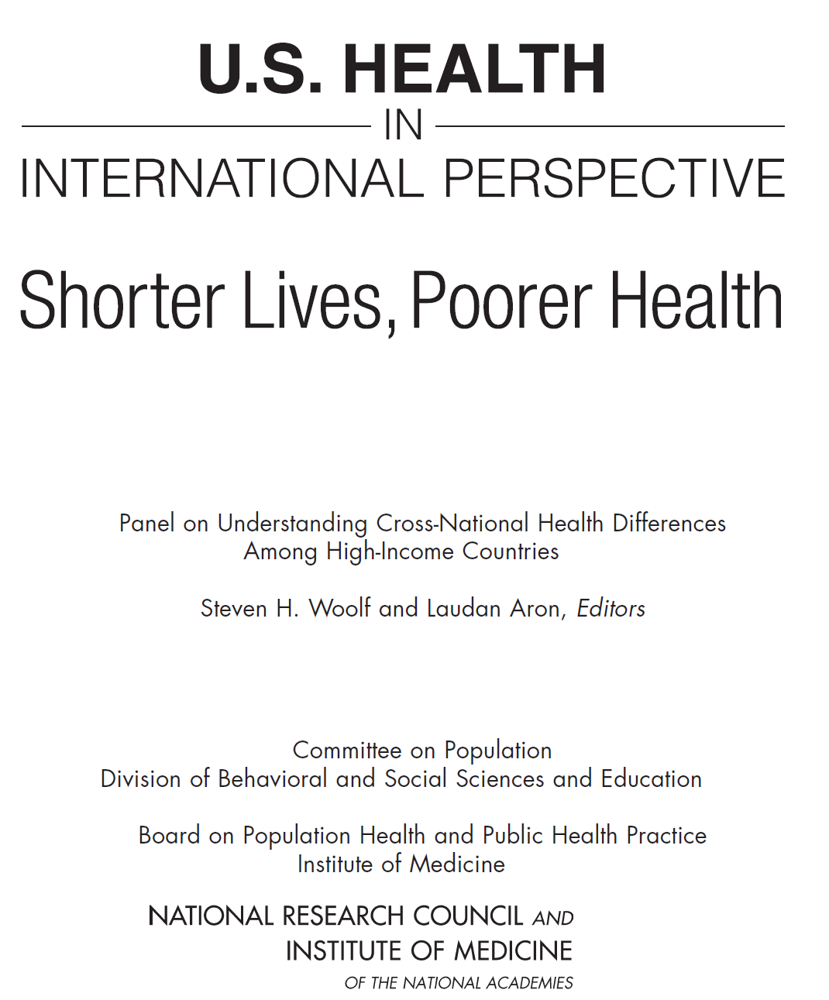
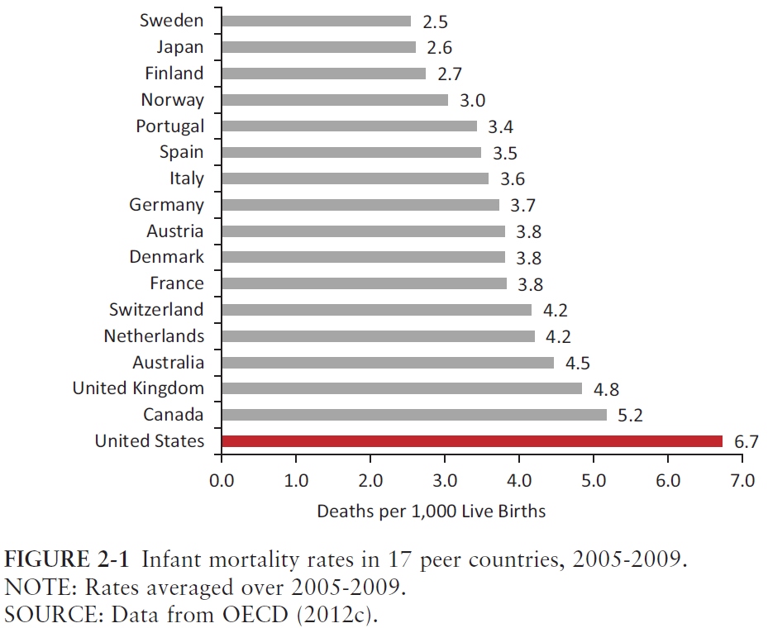
IOM chose 16 peer countries. 13 are same as the one’s we’ve used. They use 4 countries (Denmark, Finland, Portugal, Switzerland) that have <100,000 births. We include Belgium, Czech Republic, Greece and Israel
Notes:
The Institute of Medicine published in early 2013 the report described in the slide above. This 405 page study (available free online from National Academies Press website) carefully identifies 15 countries to compare to the US on a wide variety of health measures, including maternal and infant outcomes. It’s a valuable study whose findings can be easily incorporated into classrooms. For purposes of this presentation it helps affirm the choice of the comparison countries presented here. The 4 countries they use that we don’t were excluded here because they had too few births: Denmark ( ~64,000) Finland (~61,000) and Switzerland (~84,000) and Portugal (~92,000). All 4 by the way have much better birth outcomes than the U.S. The three we include that the IOM report doesn’t are Belgium, Czech Republic and Greece. Greece, while it meets our criteria, is often missing from the analysis because of limited data available.

Slide 15
How is the U.S. doing relative to comparison countries?
Neonatal Mortality Rate Infant Deaths in First 27 days X 1,000 _____________ Live Births | Perinatal Mortality Rate Fetal deaths + deaths in the first week X 1,000 _______________ Live births + fetal deaths
BirthByTheNumbers.org
Notes:
For international comparisons, the perinatal mortality rate is preferred because, by including fetal deaths, it helps balance out differences in the ways countries report on live births or fetal deaths. The problem is that perinatal mortality data often can’t be broken down by subgroups because fetal death reporting often does not include demographic characteristics of those who died.

Slide 16
Neonatal Mortality Rates (per 1,000 births), 2014, Industrialized Countries with 100,000+ Births
*2013; #2012;
Neonatal Mortality Rate
Source: OECD Health Data 2016 and NCHS, Deaths Final Data for 2014.
BirthByTheNumbers.org
Notes:
NOTE: these are rates per 1,000 live births, not % based on 100. Neonatal deaths is relatively rare in industrialized countries.
In the comparison of the 16 comparable countries we’ve identified, the US ranks last. If we limit the US births to just those to non-Hispanic white mothers, and compare that to the overall figures for other countries, the US would rank 15th out of the 16 countries. The US has wide disparities in infant outcomes between black and whites, but those disparities do not account for the US’ poor showing.

Slide 17
Neonatal Mortality Rates (per 1,000 births), 2014, Industrialized Countries with 100,000+ Births
*2013; #2012;
Neonatal Mortality Rate
Source: OECD Health Data 2016 and NCHS, Deaths Final Data for 2014.
BirthByTheNumbers.org
Notes:
NOTE: these are rates per 1,000 live births, not % based on 100. Neonatal deaths is relatively rare in industrialized countries.
In the comparison of the 16 comparable countries we’ve identified, the US ranks last. If we limit the US births to just those to non-Hispanic white mothers, and compare that to the overall figures for other countries, the US would rank 15th out of the 16 countries. The US has wide disparities in infant outcomes between black and whites, but those disparities do not account for the US’ poor showing.

Slide 18
Perinatal Mortality Rates (per 1,000 births), 2014, Industrialized Countries 100,000+ Births
Perinatal Mortality Rate
Source: OECD Health Data 2016
Notes:
Perinatal mortality, which involves fetal deaths plus deaths in the first 7 days of life is preferable for cross-national comparisons in many cases, since countries have different approaches to counting a live birth or fetal death. See for example how France went from 10th on neonatal death to last in perinatal deaths. The U.S. fares better in this comparison moving from last to 5th last.

Slide 19
Perinatal Mortality Rates (per 1,000 births), 2014, Industrialized Countries 100,000+ Births
Perinatal Mortality Rate
Source: OECD Health Data 2016
Notes:
Perinatal mortality, which involves fetal deaths plus deaths in the first 7 days of life is preferable for cross-national comparisons in many cases, since countries have different approaches to counting a live birth or fetal death. See for example how France went from 10th on neonatal death to last in perinatal deaths. The U.S. fares better in this comparison moving from last to 8th best.

Slide 20
Maternal Mortality Ratios
 | Maternal Mortality Ratio Maternal Deaths* all causes X 100,000 _______________ Live births
* Deaths in pregnancy and up to 42 days postpartum
BirthByTheNumbers.org
Notes:
Because maternal deaths are quite rare in industrialized countries, the figures are based per 100,000 births. The standard measure for deaths includes deaths during pregnancy through 42 days after the birth, though other measures use different standards (e.g. pregnancy associated mortality includes deaths up to 1 year after birth).
Maternal mortality is a ratio (rather than a rate as in the earlier measures of infant deaths), because while deaths during pregnancy are included in the numerator, the denominator is based on live births rather than pregnancies because most countries don’t maintain records of pregnancy totals, just births and deaths.

Slide 21
Maternal Mortality Rates, (per 100,000 births), 2013, Industrialized Countries with 300,000+ births
U.S. 2007:
Black non-Hispanic 28.4
White non-Hispanic 10.5
Hispanic 8.9
#2007; *2011;^2012
Maternal Mortality Ratio
Sources: OECD Health Data 2016; NCHS. 2009. Deaths, Final Data, 2007.
Notes:
Given maternal mortality rates are reported per 100,000 live births, we limited the examination to the 10 countries in our comparison group with at least 300,000 births annually. The US again ranks last and even limiting the comparison to non-Hispanic white mothers, the US still would be 9th out of the 10. The mortality rate for non-Hispanic black mothers (28/100,000) would put the US in the company of Turkey (23/100,000) , Chile (26), Romania (27) and Iran (30).

Slide 22
Are things Getting Better or Worse?
Notes:
It may be that looking at contemporary rates obscures trends over time so we’ll look at how the US fares when compared to the average rates since 2000 for the other 15 comparison countries.

Slide 23
Are things Getting Better or Worse?
Yes
Notes:
It may be that looking at contemporary rates obscures trends over time so we’ll look at how the US fares when compared to the average rates since 2000 for the other 15 comparison countries.

Slide 24
Are things Getting Better or Worse?
Yes
Things are getting better in the U.S., but at a slower pace than comparable countries
Notes:
The point is that while the US has improved over recent years, we are starting from behind and the other countries are generally improving at a faster rate so we fall even further behind.

Slide 25
Examining Trends over Time

Slide 26
Neonatal Mortality Rate (per 1,000 births), 2000-2014, U.S., & Ave. for Industrialized Countries*
U.S.
4.6
15% decrease
3.9
Industrialized Countries
38% decrease
3.2
2.0
* Countries with 100,000+ births (2012): Australia, Belgium, Canada, Czech Republic, France, Germany, Greece, Israel, Italy, Japan, Netherlands, Spain, S. Korea, Sweden, U.K.
Source: OECD Health Data, 2014 & MacDorman MF, et al. Recent declines in infant mortality in the United States, 2005–2011. NCHS data brief, no 120. Hyattsville, MD: NCHS. 2013.
Notes:
Two striking findings here: (1) the comparison countries start out far better than the U.S.; and (2) they still reduced their neonatal mortality rate at a faster pace than the U.S. either proportionally (38% decrease) or in absolute terms (by 1.2/1,000 vs. 0.7/1,000).

Slide 27
Neonatal Mortality Rate (per 1,000 births), 2000-2014, U.S., & Ave. for Industrialized Countries*
U.S.
4.6
15% decrease
If the U.S. neonatal mortality rate equaled the current average rate of the other countries in 2014, that would mean about 7,658 fewer deaths to babies 28 days or younger annually.
3.9
Industrialized Countries
38% decrease
3.2
2.0
* Countries with 100,000+ births (2012): Australia, Belgium, Canada, Czech Republic, France, Germany, Greece, Israel, Italy, Japan, Netherlands, Spain, S. Korea, Sweden, U.K.
Source: OECD Health Data, 2014 & MacDorman MF, et al. Recent declines in infant mortality in the United States, 2005–2011. NCHS data brief, no 120. Hyattsville, MD: NCHS. 2013.
Notes:
There were 15,720 neonatal deaths in the U.S. in 2015. If the U.S. rate were 2.0 (the average of the comparison countries), there would have been 8,062 neonatal deaths or 7,658 fewer each year. That figure times the 15 years of data represented here totals 114,870 fewer deaths or more than people who can fir into the Rose Bowl.

Slide 28

>100,000 fewer neonatal deaths 2000-2014
Capacity – 92,524
Notes:
There were 15,720 neonatal deaths in the U.S. in 2015. If the U.S. rate were 2.0 (the average of the comparison countries), there would have been 8,062 neonatal deaths or 7,658 fewer each year. That figure times the 15 years of data represented here totals 114,870 fewer deaths or more than people who can fir into the Rose Bowl.

Slide 29
Perinatal Mortality Rates, 2000-2014 , U.S., & Ave. for Industrialized Countries*
* Countries with 100,000+ births (2012): Australia, Belgium, Canada, Czech Republic, France, Germany, Greece, Israel, Italy, Japan, Netherlands, S. Korea, Spain, Sweden, United Kingdom
Sources: OECD Health Data 2016; NCHS. 2012. Fetal & Perinatal Mortality, 2006.
Notes:
In the case of perinatal mortality, we see a similar pattern to the case of neonatal mortality, with the U.S. beginning with a rate higher than the comparisons country. However, the differences in the case of perinatal mortality are much smaller in terms of absolute rate differences and trends over time.

Slide 30
Maternal Mortality Ratios (per 100K births), 2000-2013, U.S. & Comparable Countries *
Case Ascertainment?
U.S. 124%
Increase
OECD 19% Decrease
* Countries with 300,000+ births (2012): Australia, Canada, France, Germany, Italy, Japan, S. Korea, Spain, United Kingdom
Sources: OECD Health Data 2015; ^California Maternal Quality Care
Collaborative (CMQCC) 2014; NCHS. 2009. Deaths, Final Data, 2007.
NOTE: 2008-2013 US
rates unofficial^
Notes:
The comparison here is to the 9 other comparison countries with at least 300,000 births, given the rarity of maternal deaths.
For some technical reasons that have to do with a 2003 revision to US death certificates that has changed reporting, the U.S. has not reported an official rate for maternal mortality since 2007. The California Maternal Quality Care Collaborative has analyzed national data and estimated the figures seen in the dotted line and CDC has published a rate of pregnancy associated deaths that parallels this trend.
The reference to case ascertainment involves a major claim for the US poor standing is that the US has improved its identification of cases of maternal deaths. There is also some evidence that the improved system of recording may be also include some false positives – though not enough to make up the difference between the U.S. and the comparison countries. However, the argument is difficult to sustain when one considers that the other countries the US is being compared to are also improving their case ascertainment as well. It may be that better ascertainment accounts for the relatively small decrease for the comparison countries as well as the a portion of the rise in the US rate.

Slide 31
What about process?
Notes:
Moving past outcomes we can look at how birth is carried out, with particular attention to cesarean birth.

Slide 32
US Cesarean Rates, 1989-2015
1,272,503
%
If the 2015 cesarean rate was the same as in 1996, there would have been 449,000 fewer cesareans in the U.S. in ’15.
Source: National Center for Health Statistics Annual Birth Reports
Notes:
There were 3,978,497 births in the US in 2015. If the 1996 rate of 20.7% had been maintained, there would have been 823,549 cesareans.
In 2010 for the first time in 13 years, the US cesarean rate decreased slightly (from 32.9% to 32.8%). It stayed level for the next several years and then experienced a more notable drop between 2013-2014 (0.5 percentage point) and dropped another two-tenths in 2015 to 32.0, the lowest rate since 2007.

Slide 33
Primary Cesarean and VBAC Rates, U.S., 1989-2011
r = -.95
9.2%
Note: 2005-2011
unofficial
Source: NCHS. Annual Birth Reports & Vital Stats
Notes:
There has been a strong relationship in the culture of interventions. As the rate of vaginal birth after cesareans (VBAC) changed in the U.S., the primary cesarean rate changed in an almost perfect negative correlation over time. Increases in one corresponded closely to decreases in the other.
The reason this data is unofficial after 2005 is that NCHS did not publish an official rate after 2004 because of the delayed adoption of the revised birth certificate . The revision included a new, more accurate measure for method of delivery and the states with the new certificate generally reported a slightly higher VBAC rate. The “unofficial” rate reported here blends data from revised and unrevised states which likely leads to an undercount of the actual rate.
The reason the data presented here does not go past 2011 is that NCHS stopped releasing method of delivery from the unrevised states after 2011.

Slide 34
Cesarean Rates (%) in Industrialized Countries* with 100,000+ Births, 2014
* No data on cesarean rates in Greece and Japan
Notes:
The US is in the upper group of country cesarean rates, but not the highest with Italy, Australia and Korea having higher rates. Two countries dropped from this analysis this year because their number of births went below 100,000, Hungary and Portugal, also have higher rates than the U.S. Most comparison countries have lower rates, most notably the Netherlands, Sweden, Belgium, and Japan – all countries with very different systems.
Cesarean rates have been leveling off in industrialized countries in recent years. This applies to the US as well with cesarean rates of 32.9, to 32.0 from 2009-2015.

Slide 35
VBAC Rates Industrialized Countries, 2010
Notes:
The US ranks near the bottom when compared to other industrialized countries on VBAC rates. On the plus side, we’re higher than Latvia and Cyprus. Many countries don’t regularly report VBAC rates but a collaboration of researchers from European countries put together a report entitled Euro-Peristats (http://www.europeristat.com/) that provides data that can be used to estimate VBAC rates. Their most recent publication involved data from 2010, hence that was our point of comparison.

Slide 36
Do High Rates of Intervention Matter?
1. Outcomes
2. Costs
Notes:
What’s the problem with high rates of intervention? Interventions in and of themselves can be critical to the saving of maternal and infant lives. The question is whether there is a point at which interventions that are helpful for high risk cases, become so widely applied to the general population that they create problems where they wouldn’t otherwise have existed.

Slide 37
Gestational Age, U.S. All Births, 1990
Notes:
This is the distribution by week of gestational age in 1990. Notice the peak at 40 weeks, which is what it has been ………forever.

Slide 38
Gestational Age, U.S. All Births, 2015
Notes:
This is the distribution by week of gestational age in 2015. Now there’s a clear peak at 39 weeks. In 25 years the U.S. shifted a pattern that had been in existence for millennia by a full week earlier.

Slide 39
Gestational Age, U.S. All Births, 1990, 2015
Notes:
The comparison is clearer when you see the two distributions side-by-side.

Slide 40
Gestational Age, U.S. All Births & Planned Home Births that Occur at Home, 2015
Notes:
There’s nothing natural about the new gestational age pattern. Here’s the distribution of planned home births that occurred at home in 2015 in the U.S. and it peaks clearly in 2015.

Slide 41
Economics of Childbirth in the U.S.

Slide 42
LEADING MAJOR DIAGNOSTIC CATEGORIES by NUMBER OF HOSPITAL DISCHARGES, U.S., 2014
AHRQ. 2017. HCUPnet, Healthcare Cost & Utilization Project. Rockville, MD: AHRQ. http://hcupnet.ahrq.gov. Accessed 2/17/17.
Birthbythenumbers.org
Notes:
This data is simply a reminder that childbirth is a major driver of US health care services with the 2nd and 3rd leading reasons for hospitalizations in the US in 2014.

Slide 43
MEDIAN FACILITY LABOR & BIRTH CHARGES BY MODE OF BIRTH, U.S., 2014
NOTE: Hospital charges; no physician costs
76%
  Sources: AHRQ. 2017. HCUPnet, Healthcare Cost & Utilization Project. Rockville, MD: AHRQ. http://hcupnet.ahrq.gov . Accessed 2/18/17;
Birthbythenumbers.org
Notes:
Using the same source for hospital discharge data as in the previous slide, this presents hospital charges (which are not the same as what it costs hospitals for these services) for births by method of delivery. Medians are used to avoid the impact of a limited number of very large charges. There’s a couple of points to keep in mind concerning these data:
they are best used for comparison across methods of delivery since the basis for calculating charges is the same in all 4 cases above (actual costs are generally much lower than these figures); and
these do not include physician charges for services in these cases.

Slide 44
Estimated Total Charges, Hospital Birth, U.S., 1993-2014 (000,000)
$ 62,689
$ 14,039
  Sources: AHRQ. 2017. HCUPnet, Healthcare Cost & Utilization Project. Rockville, MD: AHRQ. http://hcupnet.ahrq.gov. Accessed 2/17/17.
Birthbythenumbers.org
Notes:
Note that this charts millions of dollars so the $62,689 refers to more than 62 billion dollars in total hospital charges for birth related services. Once again this does not account for physician charges and actual costs are lower than charges, but these data can be helpful in looking at trends over time. Total charges increased by 348% between 1993-2014, while the total number of births decreased over the same period.

Slide 45
Is it hopeless?
What can be done

Slide 46
Evidence – keep an open mind and ask different questions.
Advocacy – work for change.
Notes:
The next few slides denote groups that have been actively working to improve maternity care.

Slide 47

www.acog.org/Resources_And_Publications/Obstetric_Care_Consensus_Series/Safe_Prevention_of_the_Primary_Cesarean_Delivery
Rethinking the Evidence
Safe Prevention of Primary Cesarean Delivery

Slide 48

http://www.choicesinchildbirth.org/
Childbirth Advocacy Led by Mothers

Slide 49

www.thebusinessofbeingborn.com/
Childbirth Advocacy Led by Mothers

Slide 50



https://www.childbirthconnection.org/
Childbirth Advocacy Led by Mothers

Slide 51

http://orgasmicbirth.com/online-resources
Childbirth Advocacy Led by Mothers

Slide 52

www.ourbodiesourselves.org/

Slide 53
FACEBOOK: www.facebook.com/BirthByTheNumbers
Twitter: @BirthNumbers
Email: birthbynumbers@gmail.com
Notes:
If you have questions for us, please reach out to use at one of these addresses and follow us on Facebook and Twitter.

